Slide 1
CoSMoS
Covid-19 spread monitoring system
http://app.track-covid19.info

Slide 2
Worldwide spread of Coronavirus
Number of people infected
Lives lost
2,836,000
198,000
Source: trackcorona.live
Source: trackcorona.live
Data on 25 April 2020

Slide 3

Problems
Panic
CLOSED
Time
Authorities only know the extent of the virus spread when patients visit the hospital.
Panic
People panic due to lack of information and fear of safety of the loved ones.
Complete Lockdown
Without the knowledge of the infected person and their contact points, complete lockdown is necessary.

Slide 4

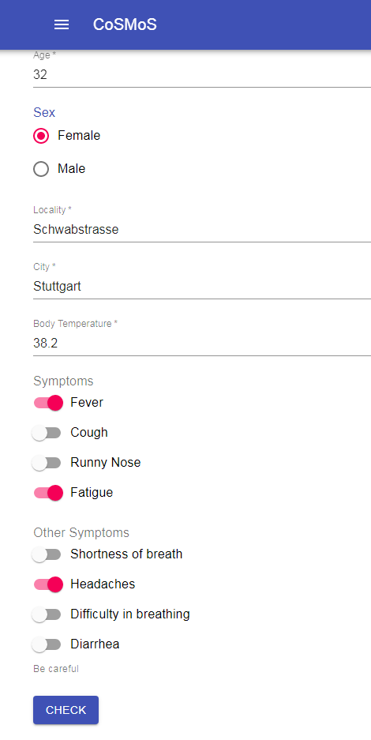
Solution
Covid-19 Spread Monitoring System (CoSMoS) universal Track & Trace System
Real-time risk estimate of user’s health condition.
Tracing the user with severe symptoms.
The user and the authorities both are notified at the same time.
Formation of hotspot on village-to-village level.

Slide 5
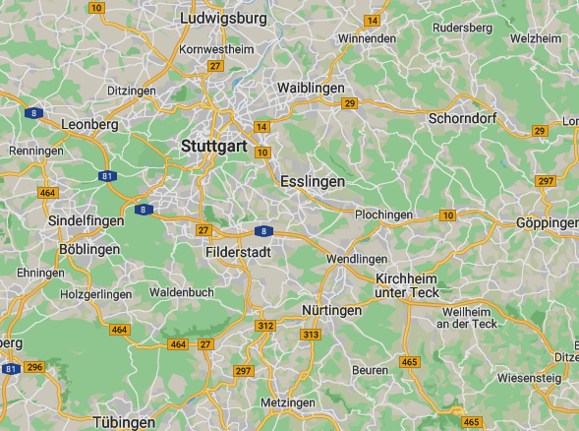
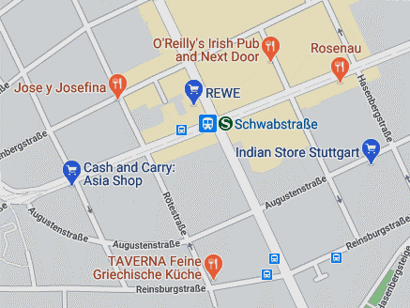
How it works
User input The user provides data about his/ her symptoms
Estimate The app estimates the risk of infection in user
Indicate The authorities are informed about the user with severe risk in real-time.
Monitoring Dashboard
Stuttgart
User’s
condition
Schwabstrasse
Confirmed
cases
Normal
moderate
Severe
845
People
with
symptoms
156
Wolrdometer*

Slide 6
Business model
Software as-a-service on a monthly subscription
We will charge the city municipality for the services we will provide.
Per city charge: 10,000€*
*Based on the economy and demography of the region.

Slide 7
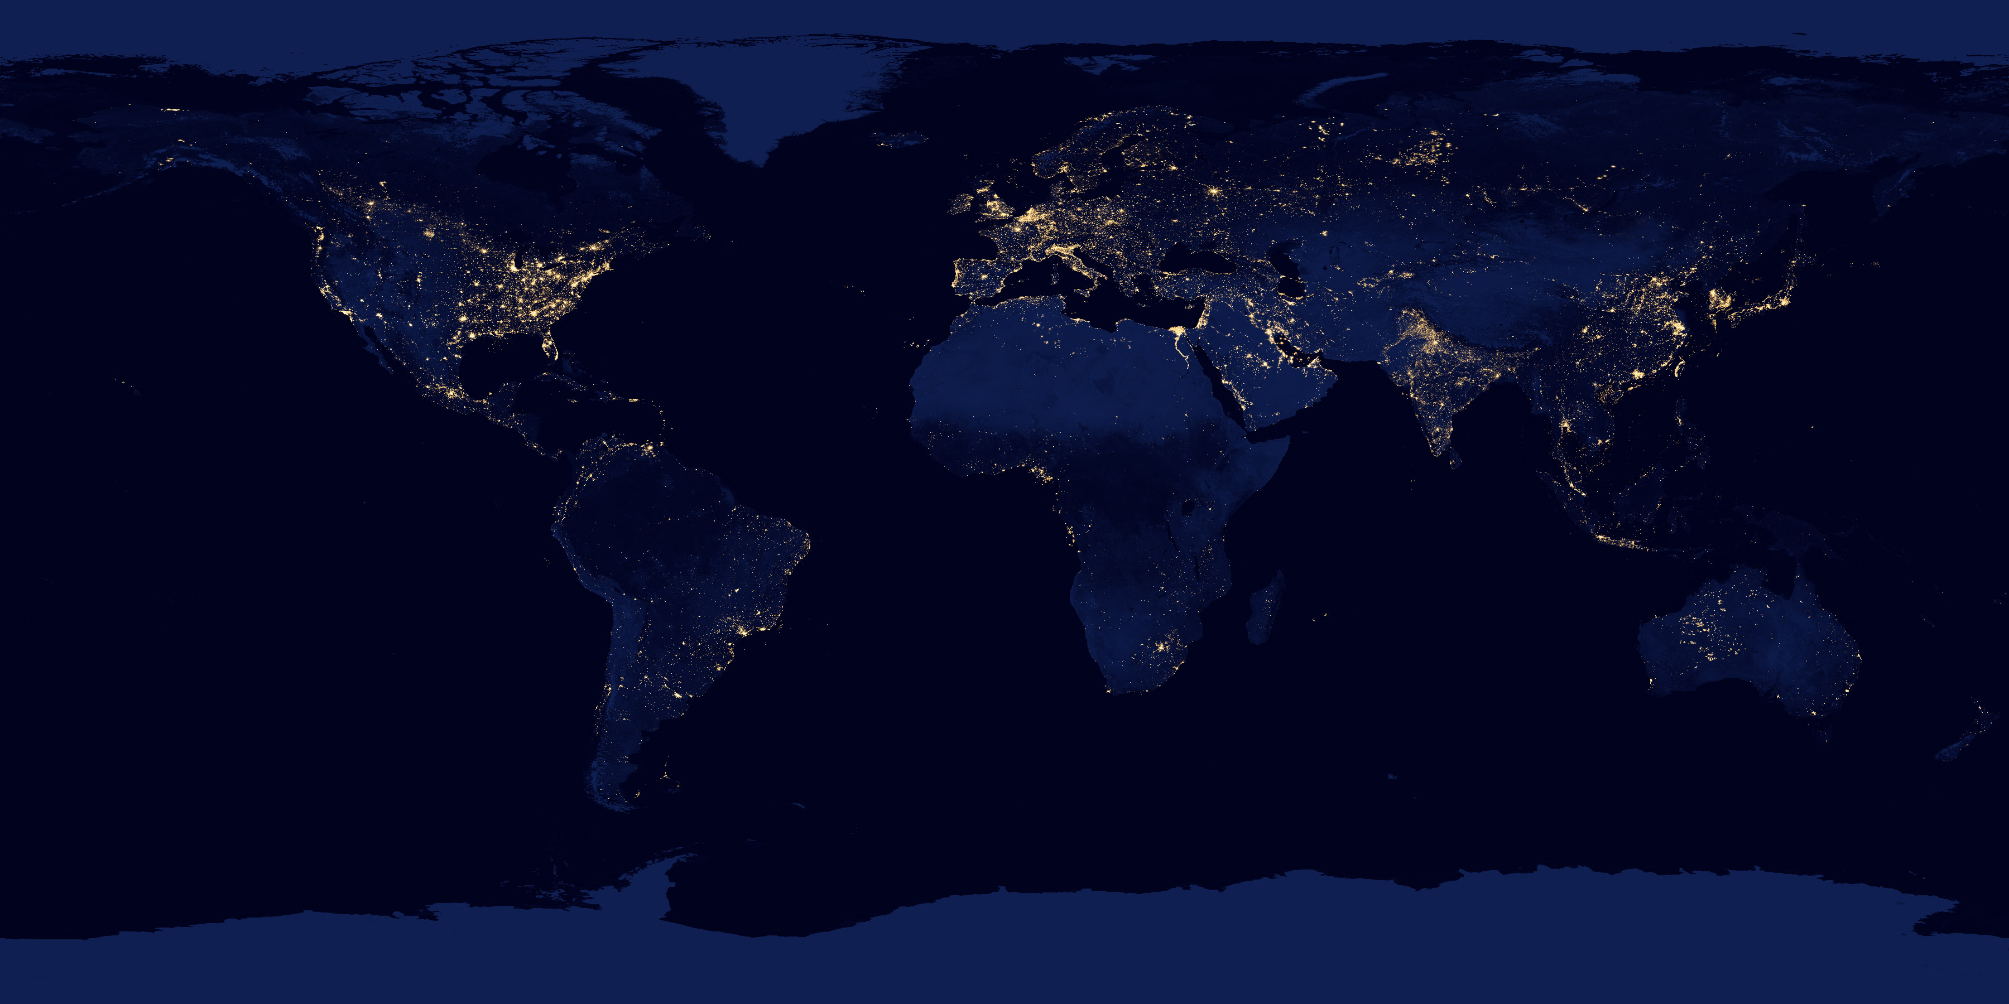
Technology
AI powered recommendation
Google based heat-maps in real-time
Bluetooth API for tracing the users
The app does not require any private information of the users.

Slide 8

Privacy
Self-identification with biometric analysis.
Encrypted user history is stored on the device itself.
In case of severe risk, the data is stored and shared in pseudonymized form with the trusted federal & local health authorities.
The hospitals and clinical centers only receive the aggregate visuals.

Slide 9



What we offer
User app
Monitoring interface for authorities
Scalable cloud solution for faster scaling

Slide 10



Competitive advantage
First to market
For real-time track and trace system.
Unique product
Real-time analysis and heat-map generation.
Secure & Easy to use
One click solution and easy to keep track of the analytics.

Slide 11

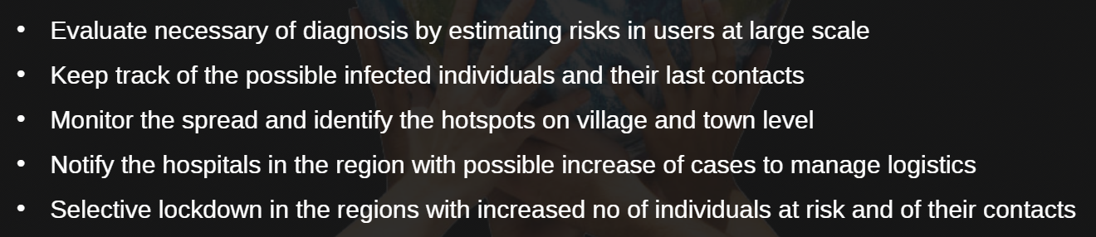
Social and economic Impact
CoSMoS is a tool for the relevant authorities to monitor the spread of the virus on village-to-village level so that quick and decisive action can be taken to limit the spread of virus.

Slide 12
CoSMoS
info@track-covid19.info
http://app.track-covid19.info

